Slide 1
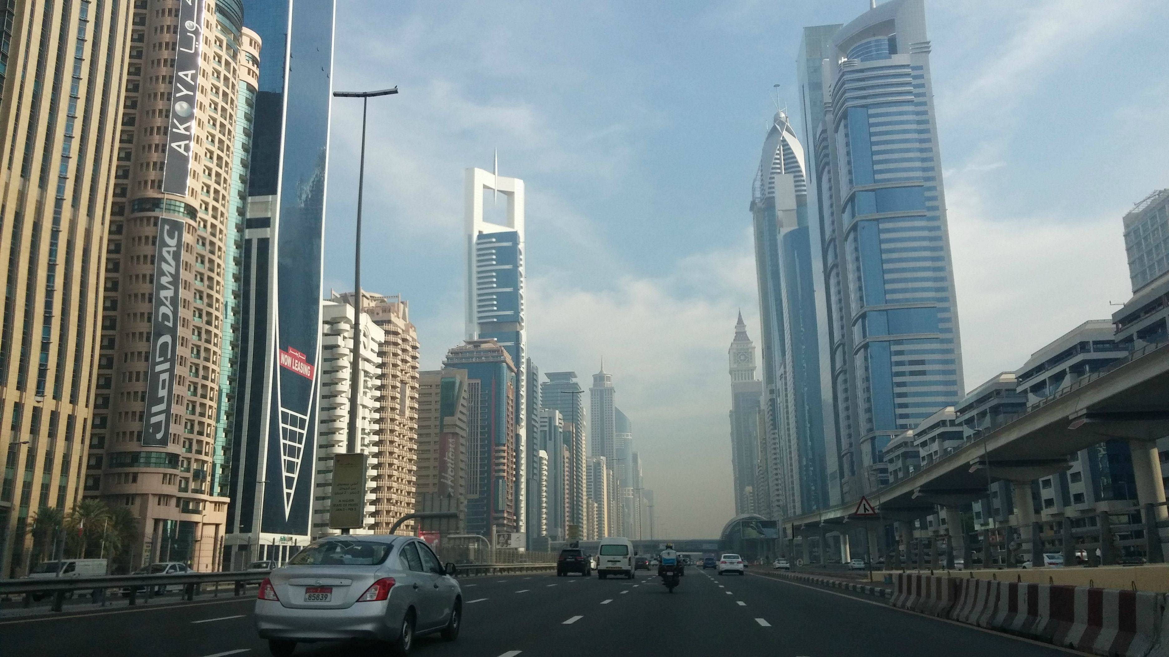
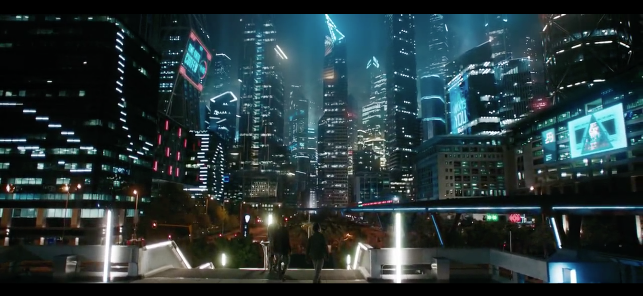
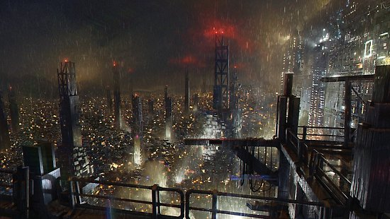
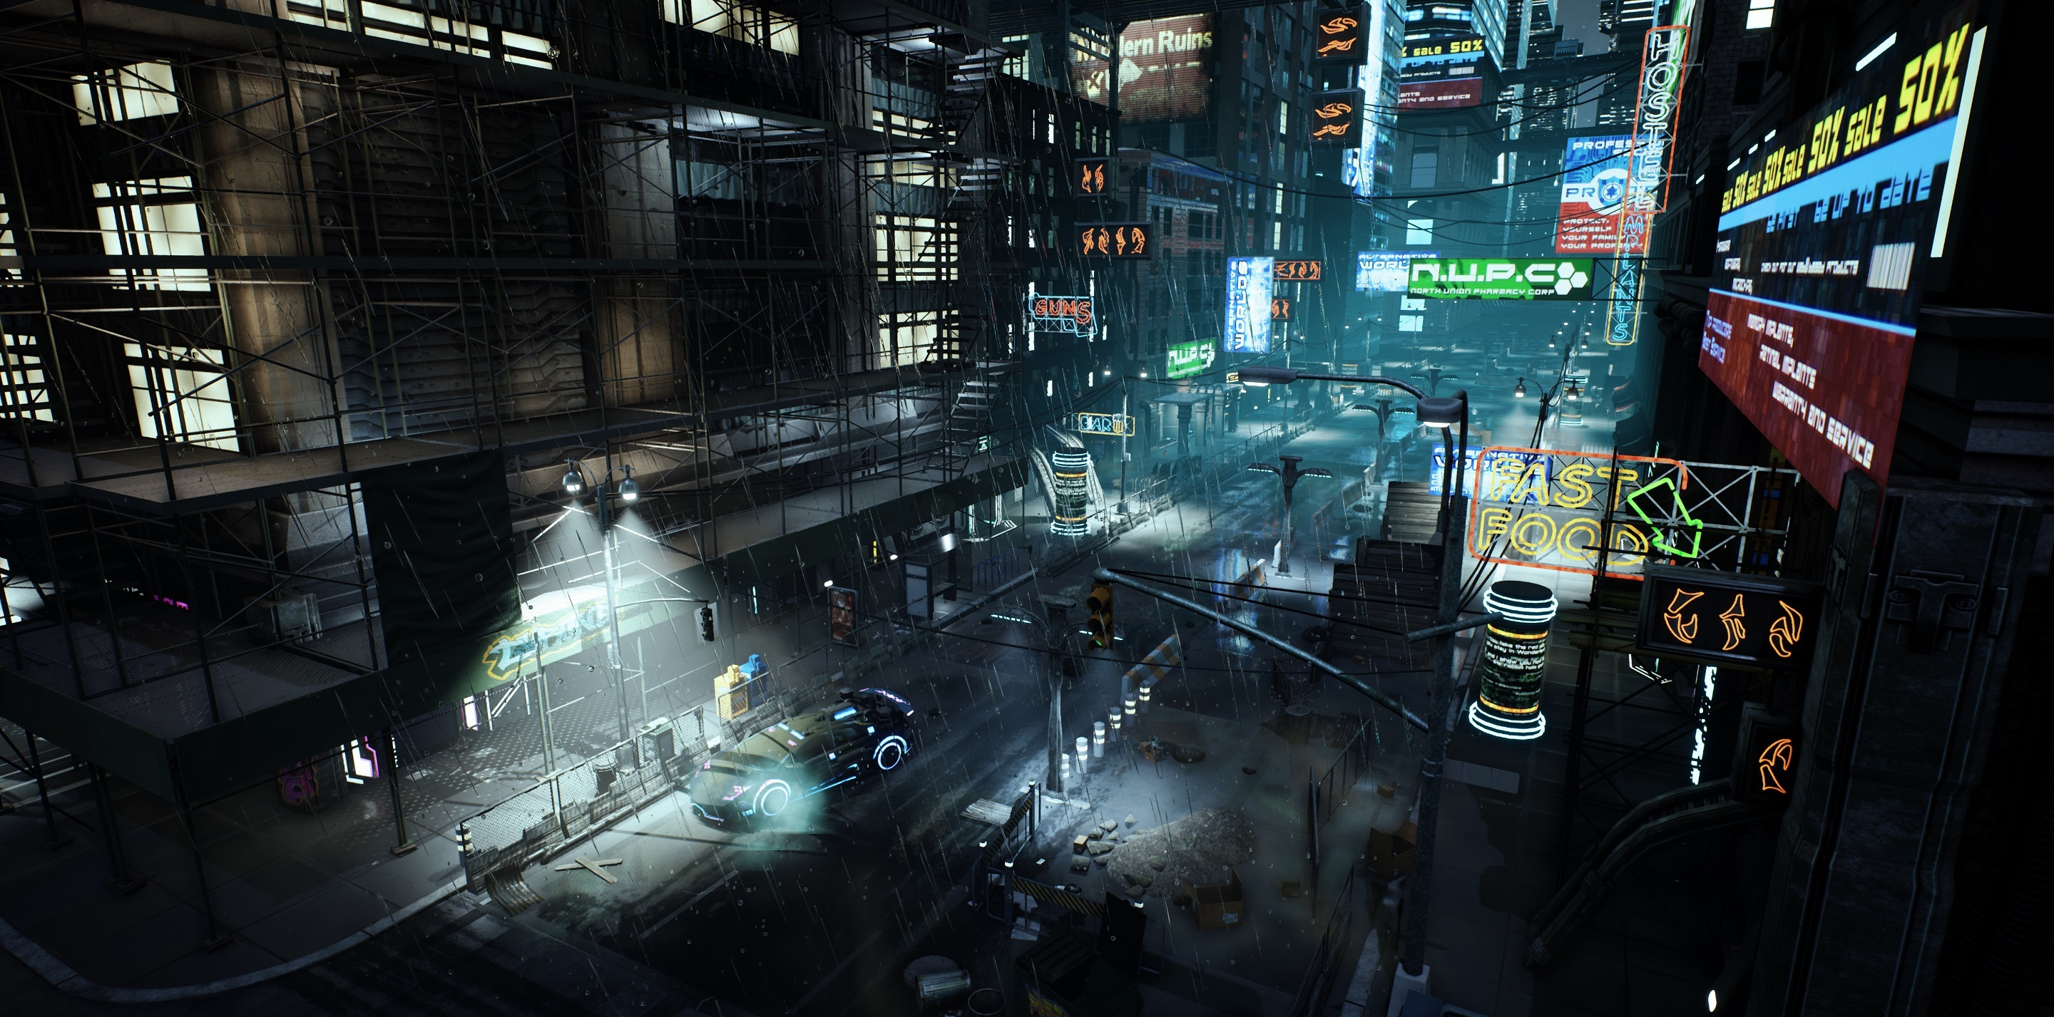
Setting
We could also try a more grounded aesthetic since are game will not take too far in the future a slightly more developed version of modern locations could work.
One way a sci fi could be depicted without going overboard would be to use a cyberpunk aesthetic.
Both of these images show a darker cyberpunk aesthetic with the lower image showing a more warn down and less polished city.
It is also possible for parts of our game to take place outside of a large city and instead take place in plains or villages to provide a variety of gameplay scenarios.
Notes:
https://www.reddit.com/r/Cyberpunk/comments/8byvep/the_maze_runner_cyberpunk_city/
https://www.reddit.com/r/CityPorn/comments/1zcwtm/dubai_uae_looks_like_driving_through_a_futuristic/
https://www.redbubble.com/people/cobain09/works/32008638-cyberpunk-city?p=poster
https://forums.cubebrush.co/t/wip-cyberpunk-city/5622

Slide 2
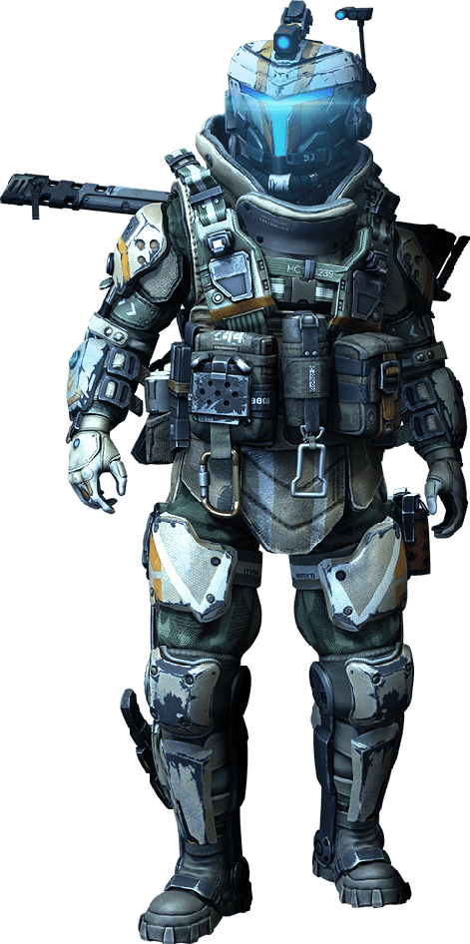
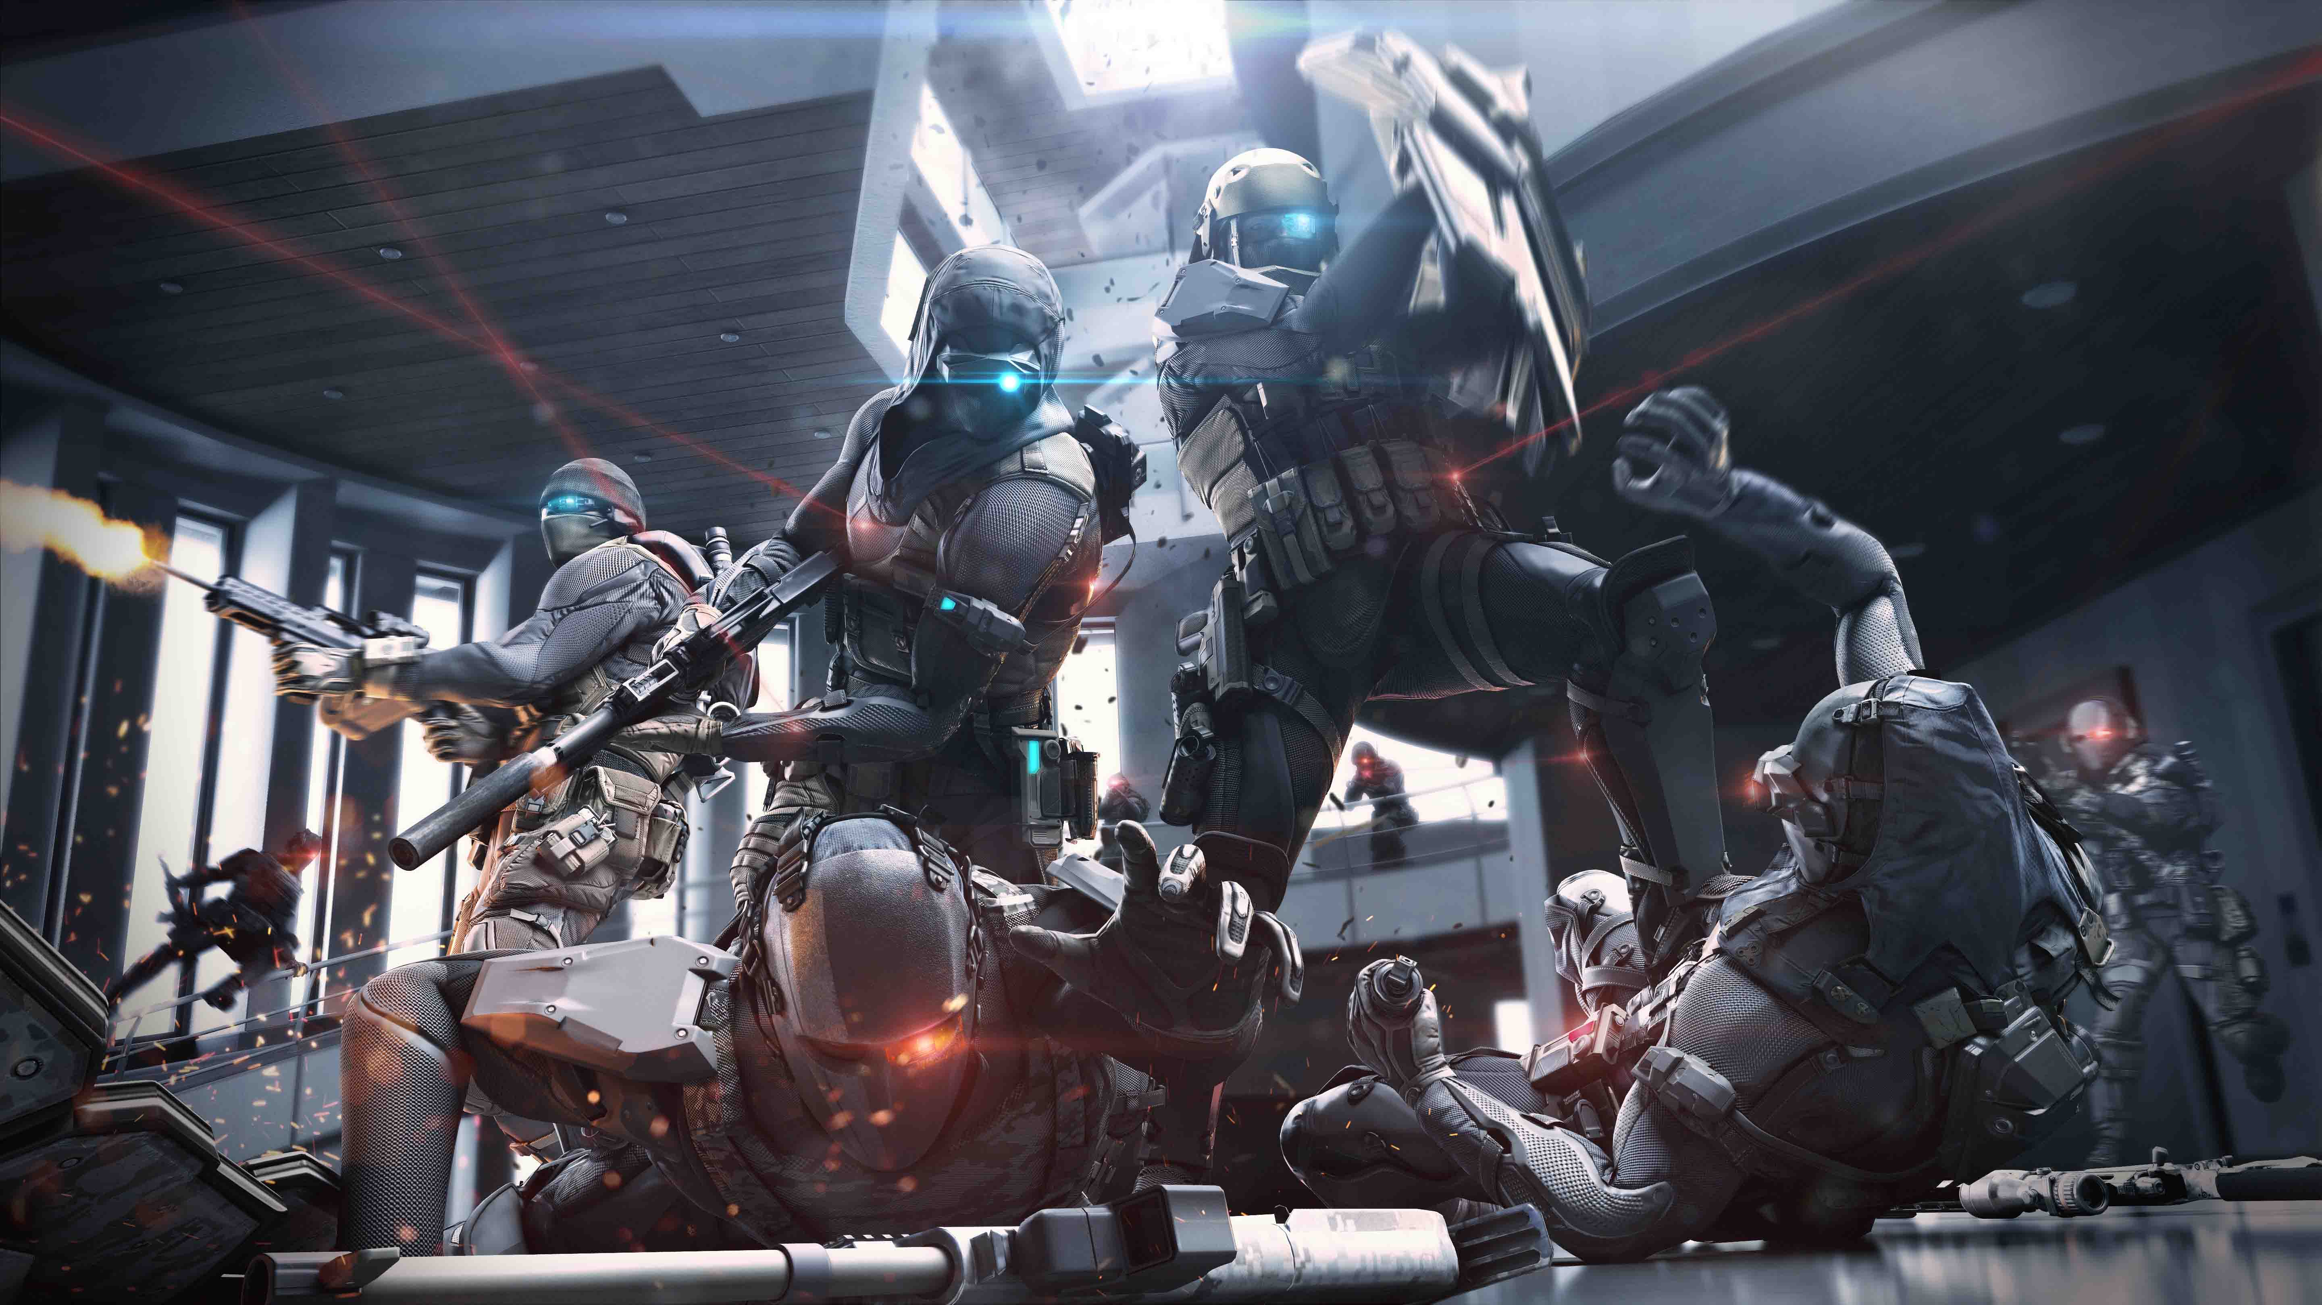
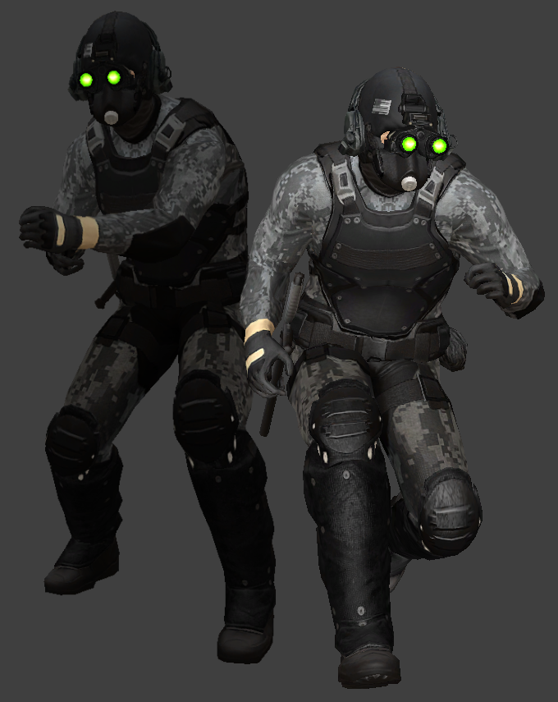
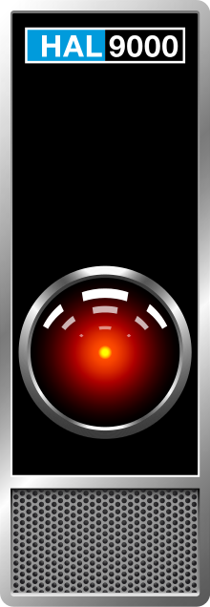
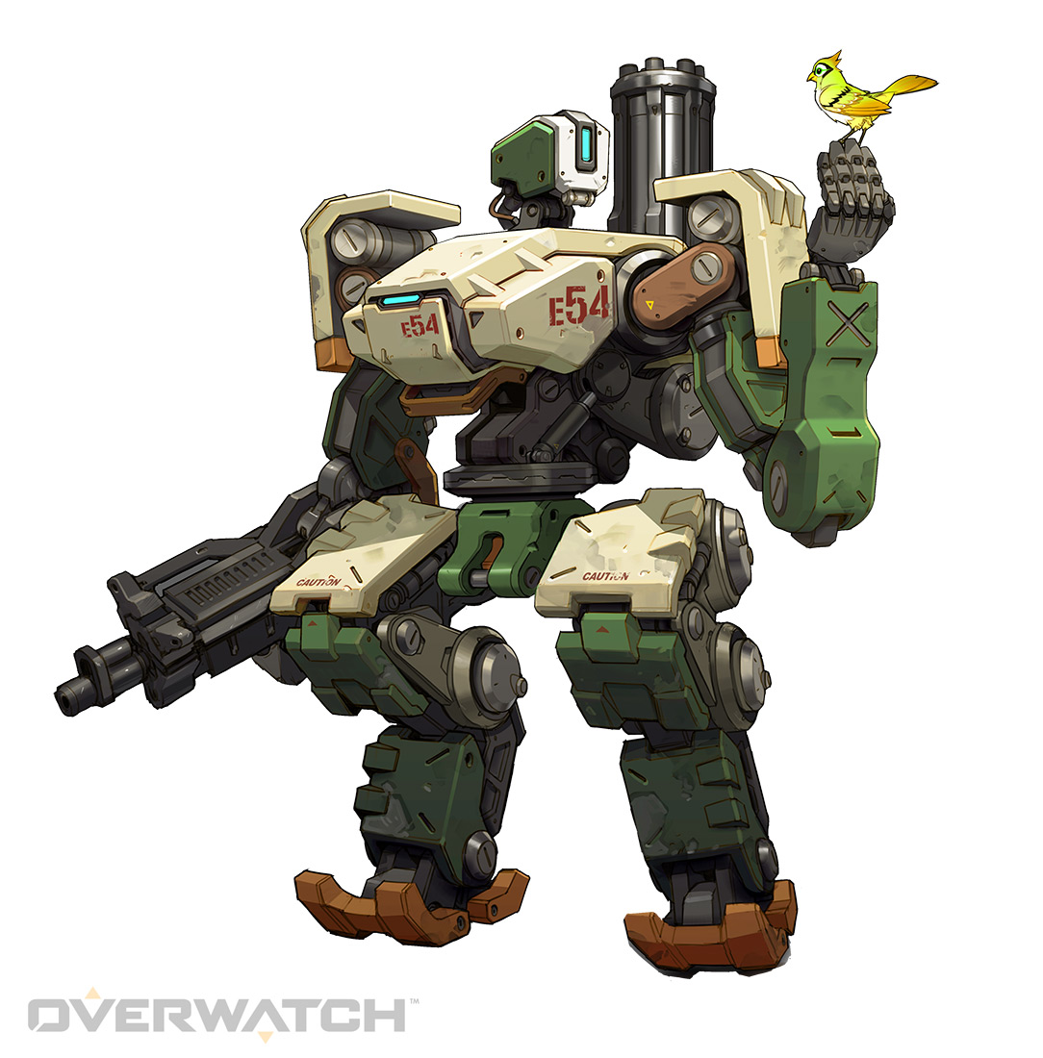
Characters
A lot of futuristic solider type characters look almost robot like, while this may work for enemy characters it might not work well for a protagonist, one way of making a protagonist stand out more would be to just remove their head ware so they look more human and the player relates to them more
While researching futuristic looking solider characters I found that the vast majority have a bright light on their head ware, and their Armor is very angular, to stay persistent to the theme we could implement this kind of feature
While our game could feature robots or AI I don’t think they should be human like are should have no physical bodies and be purely AIs or be quite restricted like modern robots but more mobile
One way of making characters look more futuristic would be to just give them futuristic looking headgear or Armor while keeping other aspects relatively modern, rather than going all out with robotic characters
Notes:
https://www.gamespot.com/articles/these-two-ubisoft-games-are-shutting-down-heres-wh/1100-6443076/
https://titanfall.fandom.com/wiki/Holo_Pilot
https://payday.fandom.com/wiki/Cloaker_(Payday_2)
https://en.wikipedia.org/wiki/HAL_9000

Slide 3
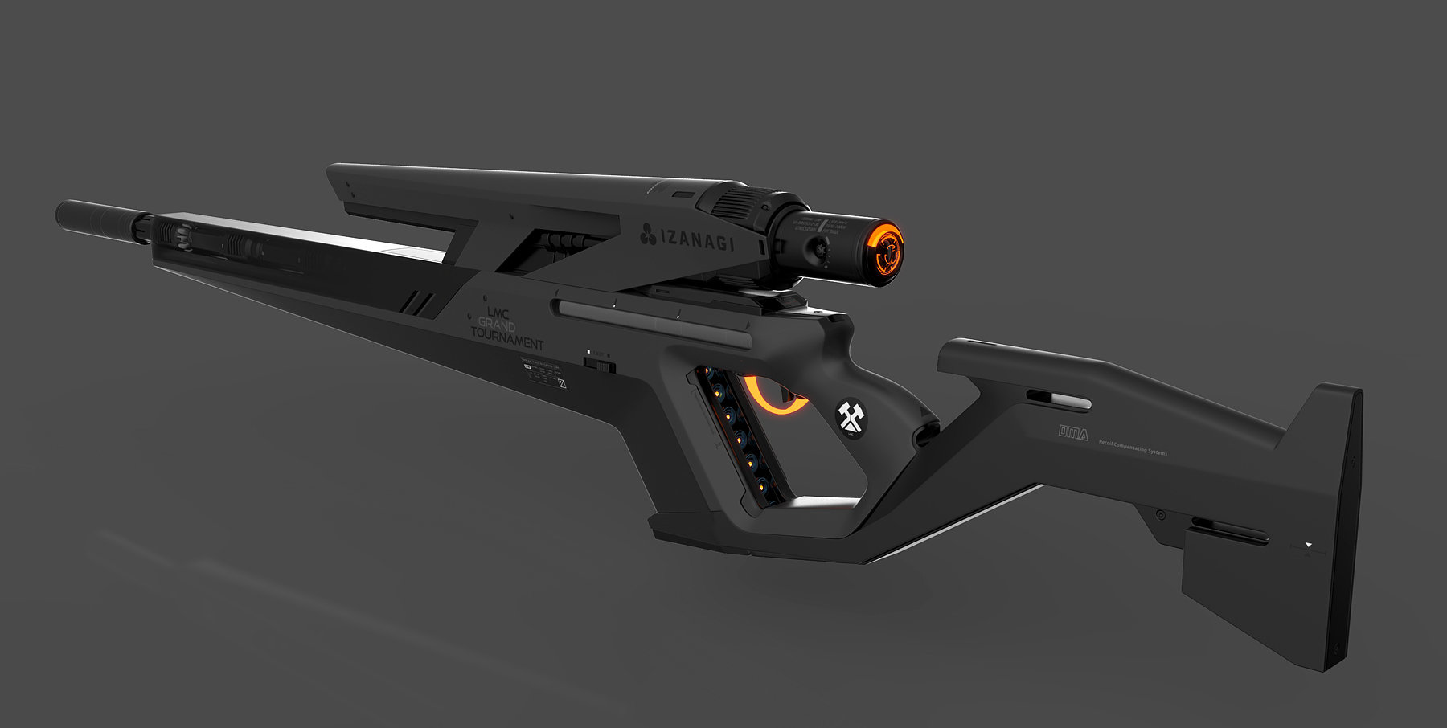
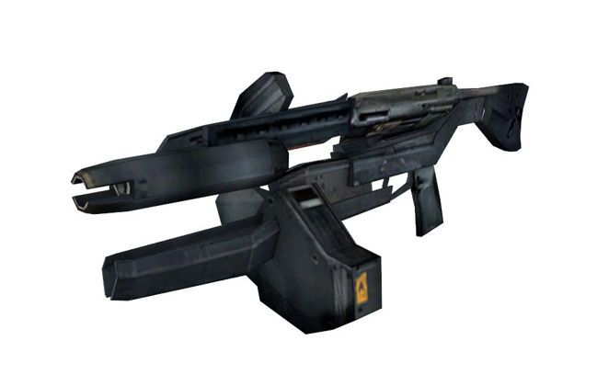
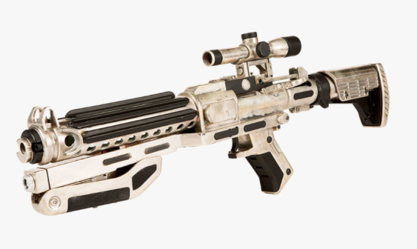
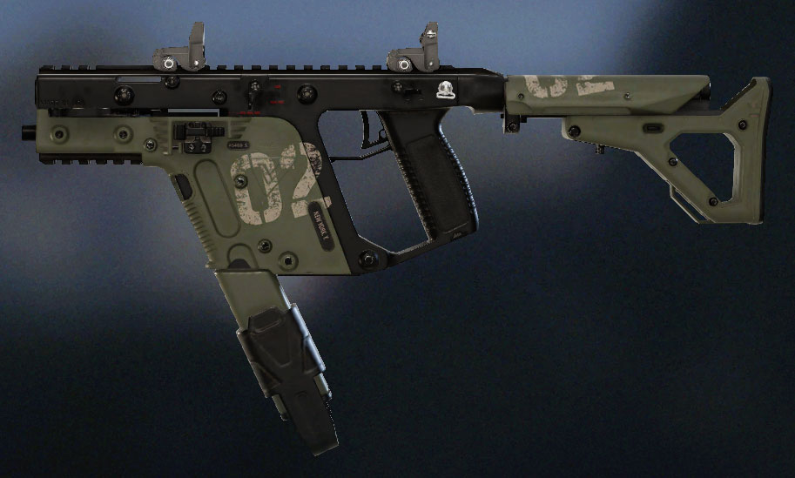
Weapons
Some futuristic weapons looks very similar to real weapons but with extra parts so we could try something similar with our game
Futuristic weapons have a tendency to use very angular design with a black finish, and like with futuristic armour, extra lighting is usually added to various point of the weapon although this might be difficult to implement based on detail.
We could also use relatively futuristic weapons that already exist depending on how futuristic we want to game to be
Sine the game will take place from a top down perspective weapons do not need a huge amount of detail.
Notes:
https://www.thetruthaboutguns.com/2015/11/foghorn/379221/screen-shot-2015-11-19-at-9-47-12-am/
https://www.artstation.com/artwork/OG4dk
http://www.papercraftsquare.com/half-life-2-full-size-overwatch-standard-issue-pulse-rifle-ar2-free-paper-model-download.html
https://rainbowsix.fandom.com/wiki/Vector_.45_ACP

Slide 4
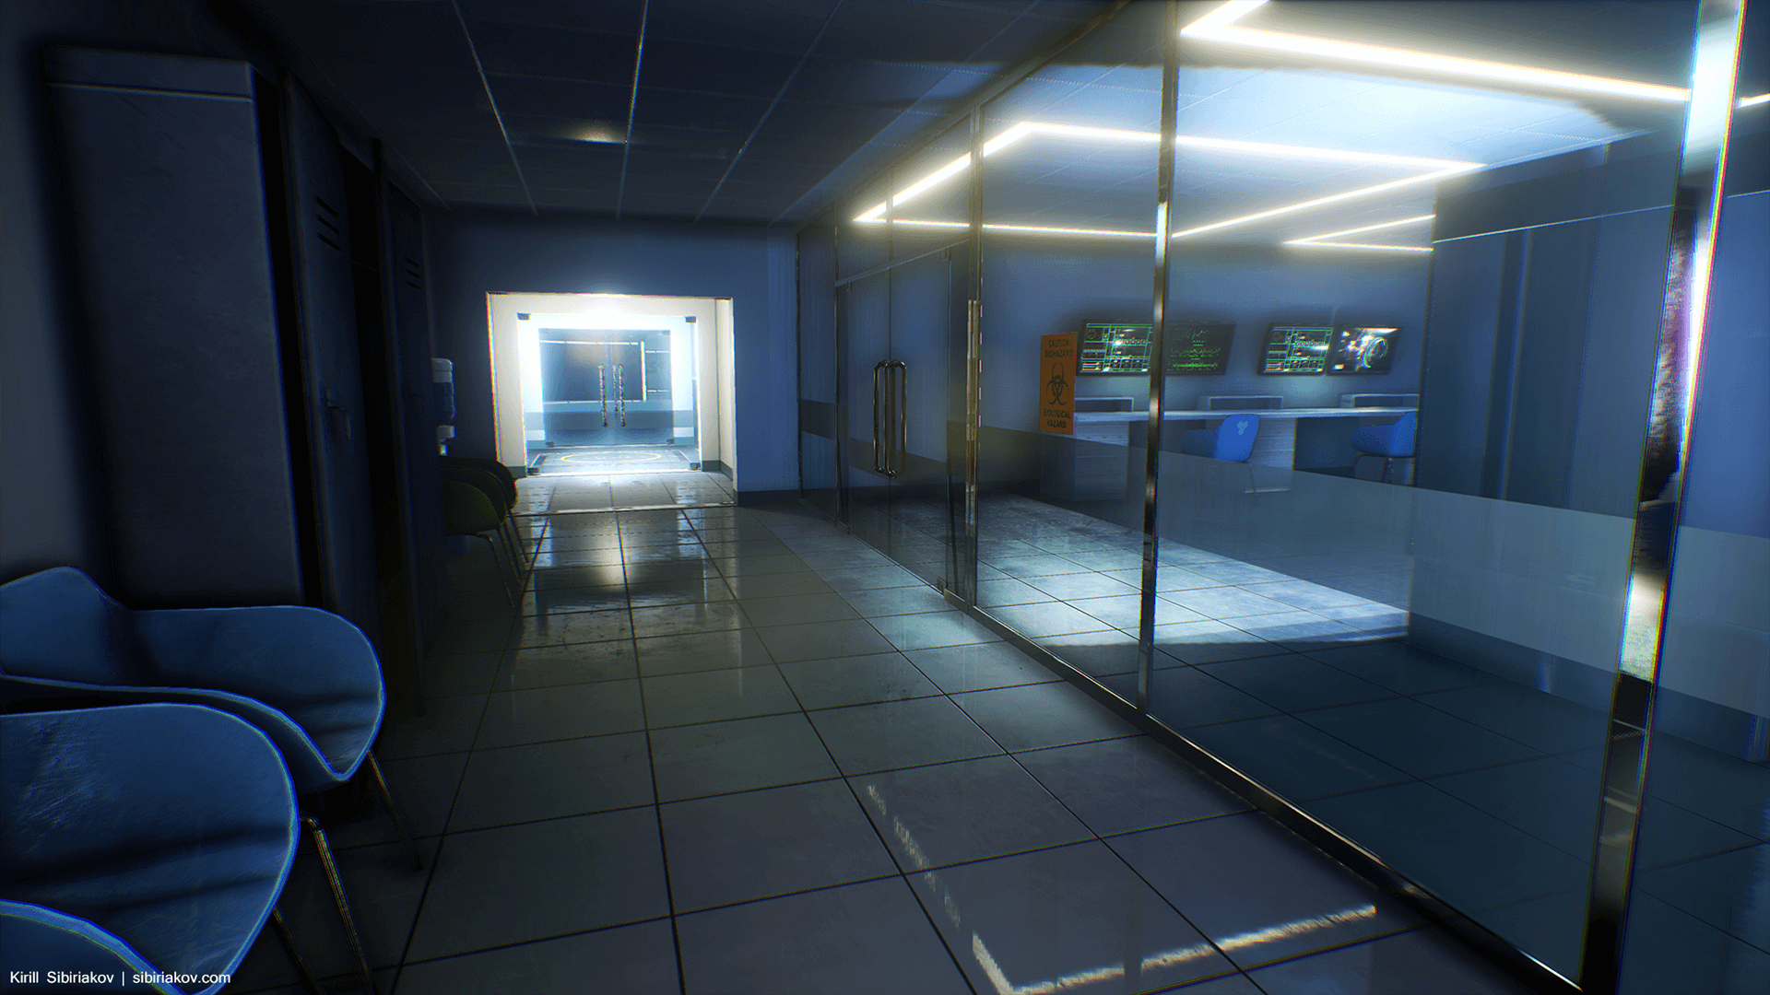
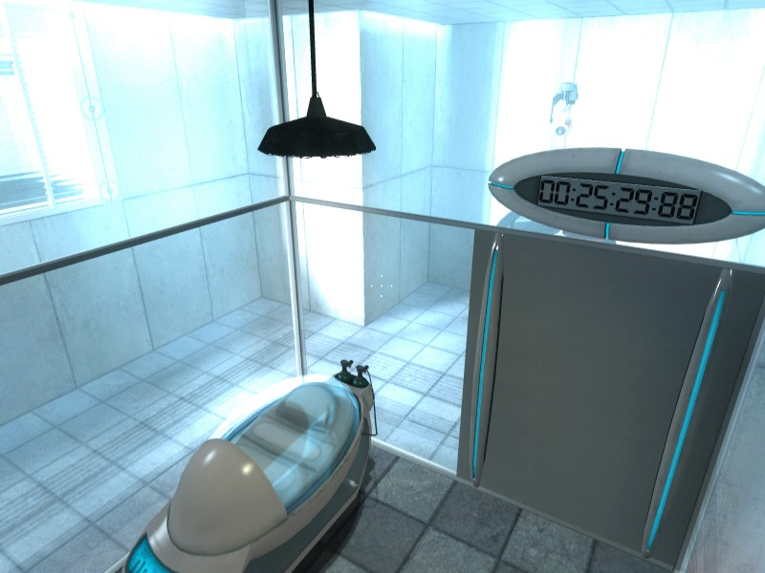
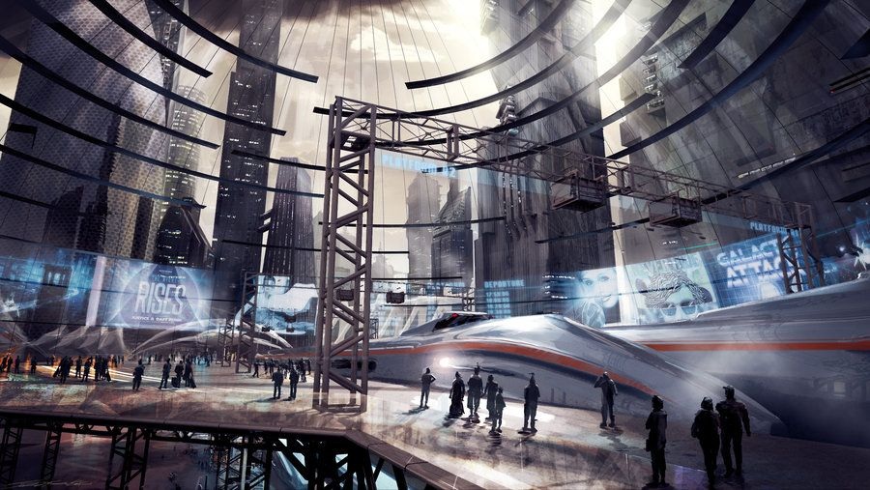
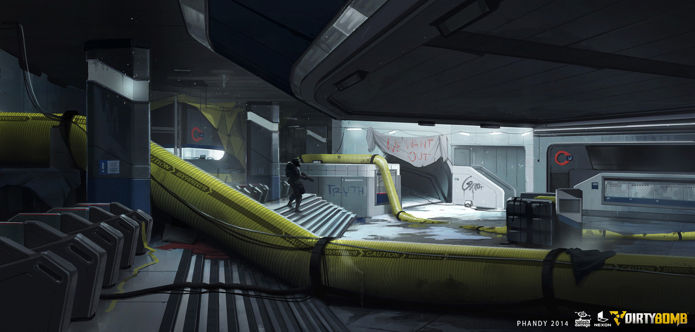
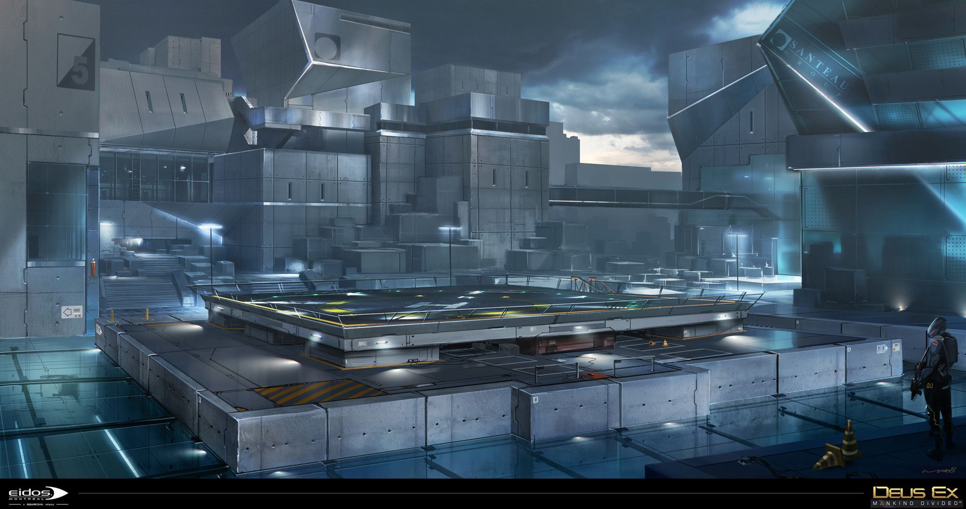
Locations (Stages)
A train station inspired stage could work quite nicely as it could have lots of pathways between smallish rooms
In is very common in science fiction to have buildings with sterile white walls and floors.
One idea for a stage could play the player on a small platform and will be unable to get close to enemies like what is shown in this picture
In the setting I described a slightly decrepit setting, underground/hazard zones would be quite fitting for this theme
Notes:
https://www.unrealengine.com/marketplace/modular-sci-fi-hospital
https://strategywiki.org/wiki/Portal/Chamber_00
https://www.pinterest.com/pin/399553798181384774/
https://www.artstation.com/artwork/lRwaV
https://www.pinterest.com/pin/409475791113838790/

